Slide 1
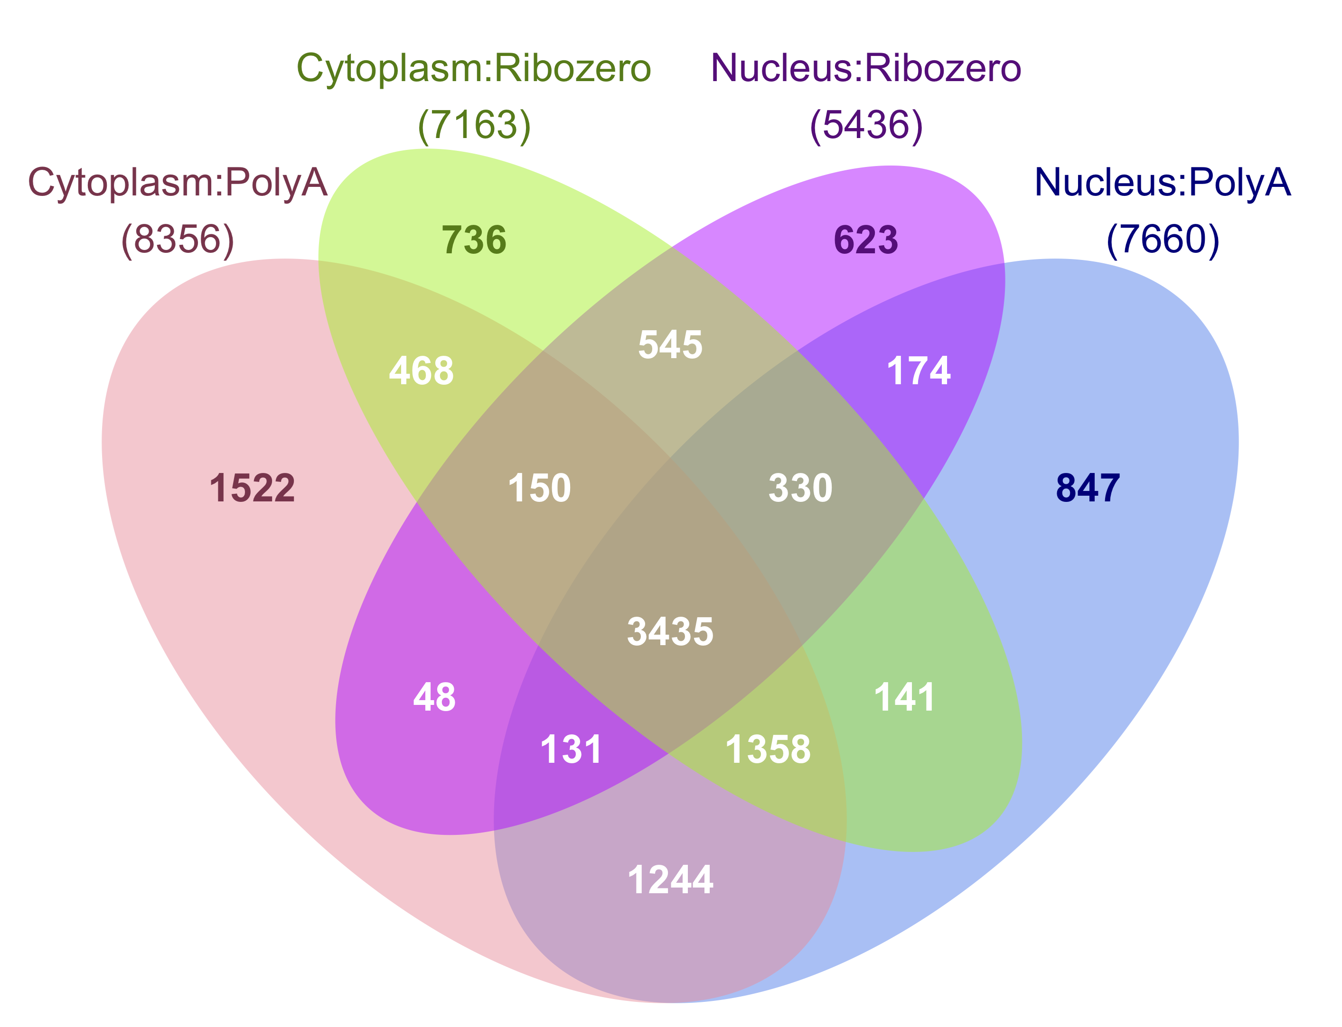
A.
B.
C.
D.
Figure 1: Developmental gene expression changes in human cortex are similarly detectable in nuclear and cytoplasmic RNA
Principal component analysis. PC1 separates the samples by age and PC2 separates the samples by library type so that nuclear and cytoplasmic samples from the same donors cluster together.
Bar plot showing the number of genes with increasing or decreasing expression by age in cytoplasmic and nuclear RNA sequenced using PolyA+ and Ribo-Zero library preparation at three False Discovery Rate (FDR) cutoffs and two log₂ fold change (LFC) cutoffs.
LFC of gene expression across age measured in cytoplasmic and nuclear RNA (PolyA+ library preparation shown only). Black dots indicate genes with agreeing sign, and gray indicate a change in LFC direction.
Venn diagram of differentially expressed genes by age (FDR≤0.05; abs(LFC)≥1) measured in both RNA fractions and library types. The total number of genes for each group are listed in parentheses.

Slide 2
A.
B.
C.
Nucleus
Prenatal
Cytoplasm
Adult
D.
Nucleus
Cytoplasm
Figure 2: Prenatal and adult human cortex show distinct patterns of RNA localization across the nuclear membrane.
MA plots of prenatal and adult gene expression differences across fraction. Red dots indicate FDR≤0.05.
Log₂ fold change (LFC) of gene expression across fraction in adult “PolyA” samples plotted against prenatal “PolyA” samples. Black dots indicate genes with agreeing sign, and gray indicate a change in LFC direction.
LFC of gene expression by age in cytoplasmic and nuclear RNA in genes higher expressed in nuclear or cytoplasmic RNA in adult samples, stratified by FDR threshold.
LFC of gene expression by fraction in adult samples in groups of genes with increasing or decreasing expression over development, stratified by false discover rate threshold.

Slide 3
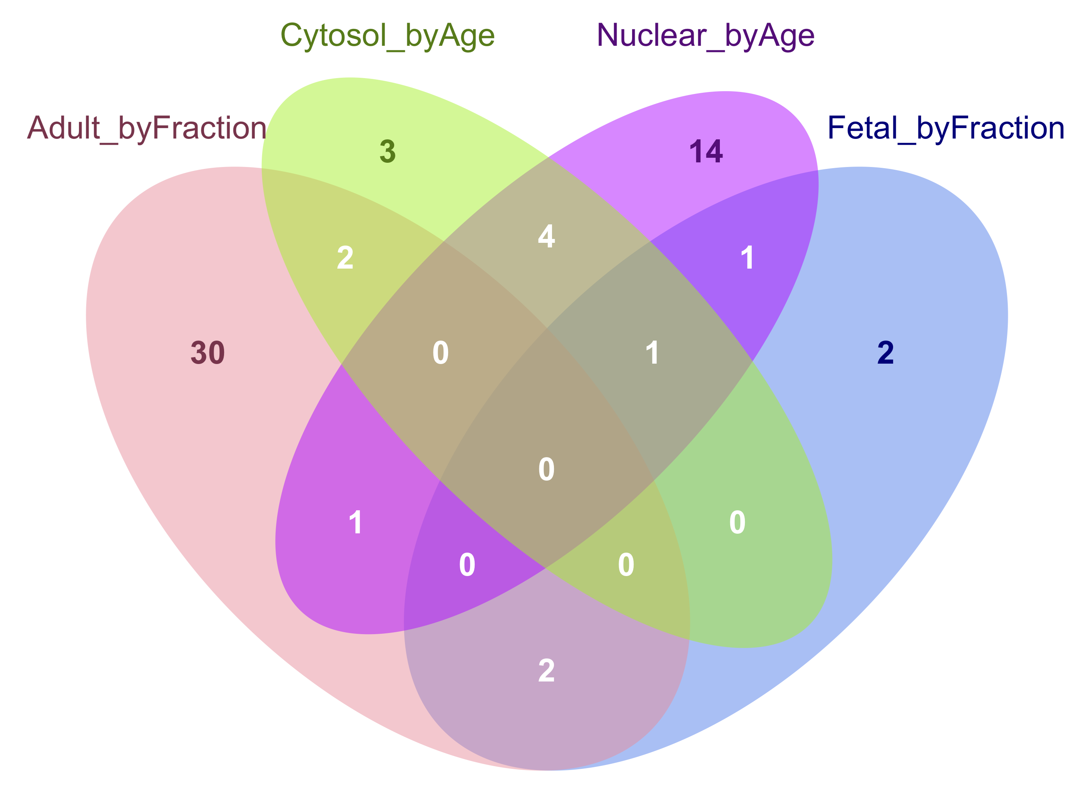
A.
B.
C.
D.
E.
F.
Nucleus
Prenatal
Cytoplasm
Adult
Figure 3: Intron retention patterns in prenatal and adult human cortex associate with RNA distribution.
Proportion of junction reads per sample by group. Prenatal cortex has a higher proportion of splice junctions than adult, and although Ribozero samples have a lower proportion of junctions in nuclear samples, PolyA samples show non-significantly different proportions between fractions.
Percentage of introns passing QC in all groups with an intron retention (IR) percentage above each threshold in at least one sample of each group.
Density plot of maximum IR ratios per genes differentially expressed by fraction (FDR≤0.05) in PolyA samples. Colors are stratified by fraction and age of the sample. Solid lines indicate genes higher expressed in cytoplasmic RNA in both ages, while dotted lines indicate higher expression in nuclear RNA in both ages.
Log2 Fold Change (LFC) of gene expression by fraction measured in adult (left panel) and prenatal cortex (right panel) for genes containing introns passing QC. The genes are stratified by whether they include an intron with greater than 0.1 IR ratio or not, and whether the gene is significantly differentially expressed by fraction (FDR≤0.05). Positive LFC indicates higher expression in nuclear RNA.
Overlap of individual introns that were differentially expressed by fraction or age (FDR≤0.05).
LFC of expression by age in genes containing an intron differentially expressed by fraction (FDR≤0.05) in adult (left panel) and prenatal (right panel) cortex. Gene expression LFC is stratified by whether the comparison was made between ages in cytoplasm or nucleus, and FDR. Positive LFC indicates higher expression in prenatal cortex.

Slide 4
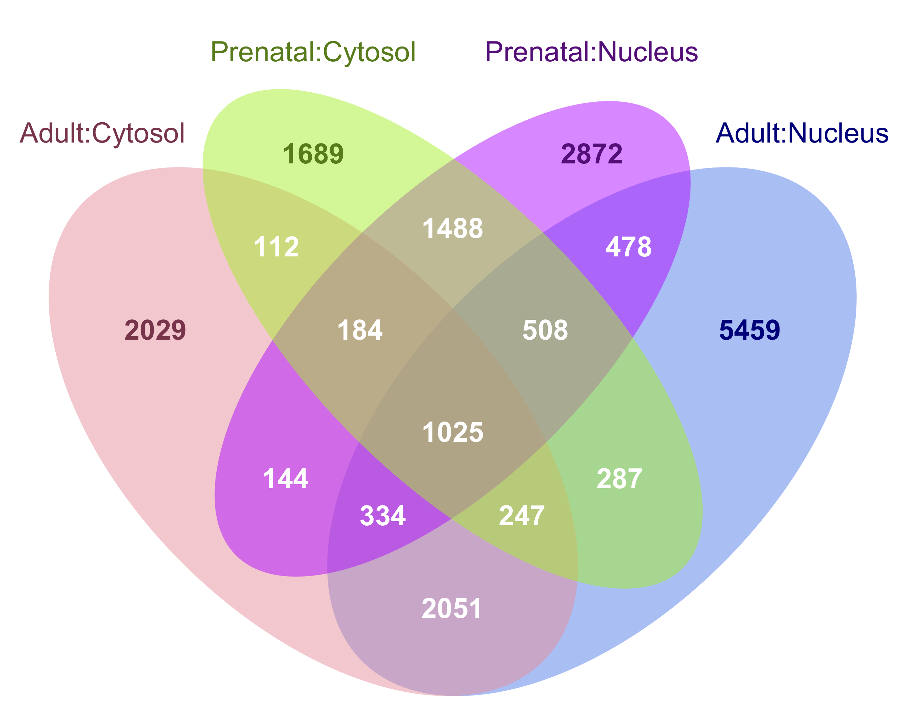
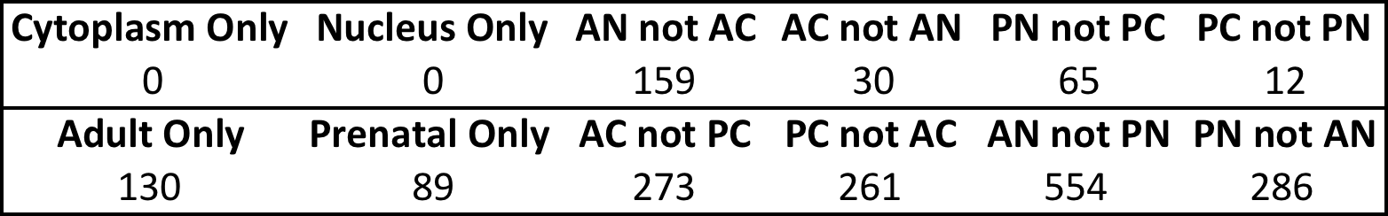
A.
B.
D.
Nuc.
Cyt.
C.
E.
Prenatal
Adult
Figure 4: RNA editing sites unique to an age/fraction group associate with expression levels.
Number of unique editing sites identified in each group stratified by editing context.
Venn diagram demonstrating the overlap of editing sites between groups of fraction and age samples.
Number of editing sites identified that were unique to each group and present in all samples in a group. For age and fraction individually, the site must be present in all six PolyA+ samples, while subsets of fraction and age must be present in the three samples. AN= adult nucleus, AC=adult cytoplasm, PN=prenatal nucleus, PC=prenatal cytoplasm.
Left two panels: LFC by fraction in genes that include an editing site present in all adult cytoplasm but no adult nuclear samples and vice versa, as measured in adult and prenatal RNA, stratified by false discovery rate. Right two panels: LFC by fraction in genes that include an editing site present in all prenatal cytoplasm but no prenatal nuclear samples and vice versa, as measured in adult and prenatal RNA, stratified by false discovery rate.
LFC by age in genes that include an editing site present in all adult but no prenatal samples (Adult Only) or all prenatal but no adult samples (Prenatal Only), as measured in cytoplasmic and nuclear RNA, stratified by false discovery rate.

Slide 5
Figure 5: Disease-associated gene length
Length in kilobases (kb) of genes in 10 gene sets associated with autism spectrum disorder (ASD), schizophrenia (SCZ), bipolar affective disorder (BPAD), neurodevelopmental disease (Neuro-devel.), intellectual disability, and neurodegenerative disease (Neuro-degen.). Where applicable, the type of study from which the gene association with disease derives is listed in parentheses. Colors indicate whether the gene set is significantly enriched for genes higher expressed in nuclear RNA in both ages or in adult cortex only (FDR≤0.05).

Slide 6
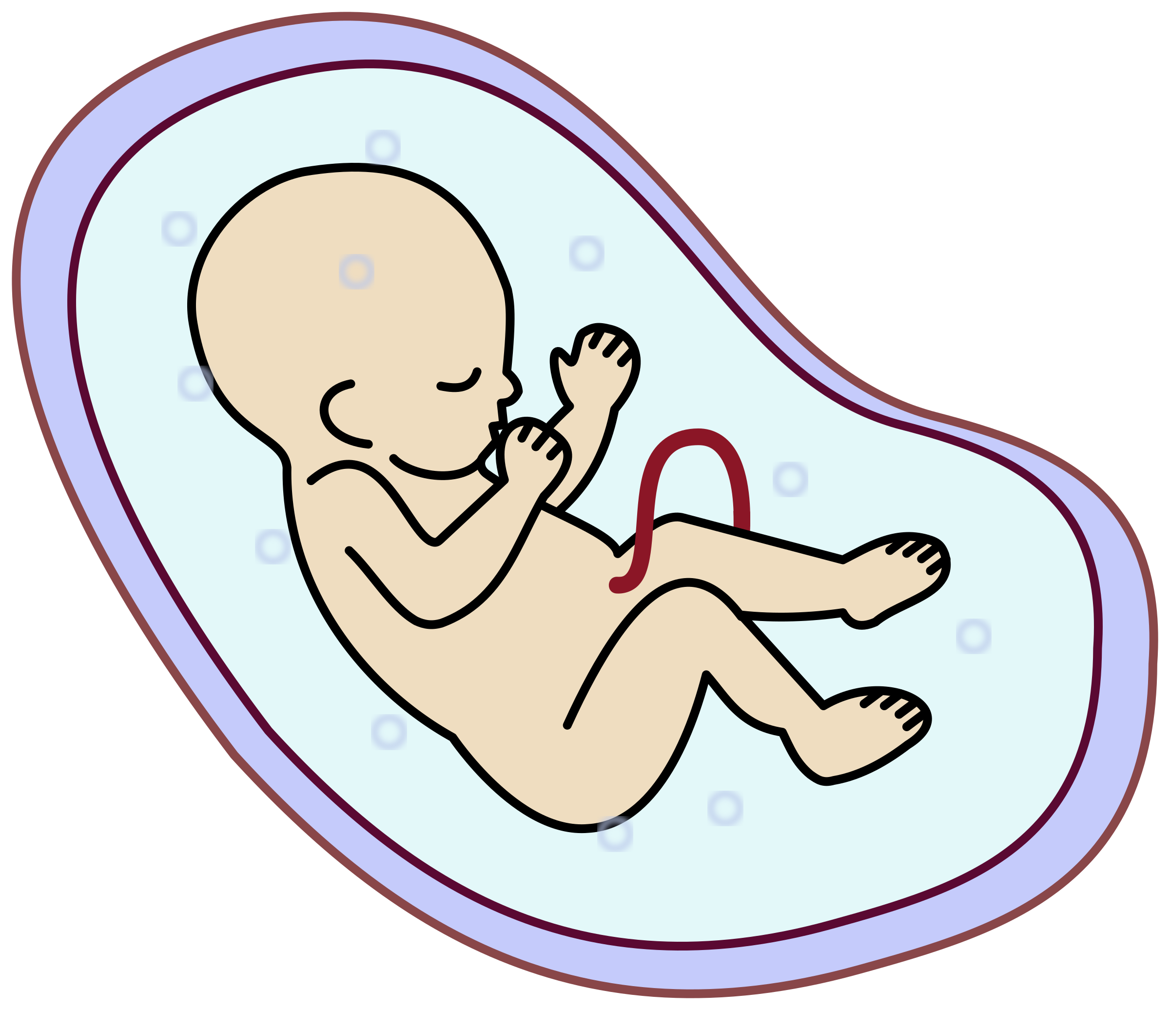

Homogenate brain tissue
RNA Fractionation
Sequencing Library Preparation
PolyA+ (N=3)
Cytoplasmic
RiboZero (N=3)
3 Fetal Brains (PFC)
PolyA+ (N=3)
Nuclear
RiboZero (N=3)
PolyA+ (N=3)
Cytoplasmic
RiboZero (N=3)
3 Adult Brains (DLPFC)
PolyA+ (N=3)
Nuclear
RiboZero (N=2)
Supplementary Figure 1: Experimental Design
We characterized the nuclear and cytoplasmic transcriptome in human prenatal postmortem prefrontal cortex (PFC) and adult postmortem dorsolateral prefrontal cortex (DLPFC) using two RNA sequencing library preparation methods. “PolyA” library preparation selects polyadenylated transcripts via a pull-down step, while “Ribozero” library preparation relies on a rRNA depletion step.

Slide 7
A.
B.
C.
⬆ Nucleus
⬆ Cytoplasm
D.
E.
Supplementary Figure 2: Characterizing the nuclear and cytoplasmic transcriptome in human brain
Differentially expressed genes in nuclear RNA by library type (FDR ≤ 0.05; abs(Log2 Fold Change) ≥ 1).
ACTB1, a cytoplasmic gene, and MALAT1, a nuclear gene, are enriched in the appropriate subcellular fractions. Error bars reflect standard error.
Distribution of lengths of genes enriched by fraction in polyA samples (FDR≤0.05; abs(LFC)≥1). “Cytoplasmic” and “Nuclear” reflect which fraction in which the gene is higher expressed, and “Adult” and “Prenatal” represent the age in which the comparison between fractions was made.
Percent of reads mapping to six genomic features in each group. TES=Transcription end site; TSS=transcription start site; UTR=untranslated region, CDS=coding; kb=kilobase.
Annotation of groups of genes differentially expressed by fraction (FDR≤0.05; abs(LFC)≥1). The total number of genes in each group is listed to the right of each bar.

Slide 8
A.
B.
C.
D.
Supplementary Figure 3: Comparing Fraction and Age in RiboZero Samples
Annotation of groups of genes differentially expressed by fraction in adult and prenatal RNA (FDR≤0.05; abs(LFC)≥1). The total number in each group is listed to the right of each bar.
Annotation of groups of genes differentially expressed by age in cytoplasmic and nuclear RNA (FDR≤0.05; abs(LFC)≥1). The total number in each group is listed to the right of each bar.
MA plots of prenatal and adult gene expression differences measured across fraction. Red dots indicate FDR≤0.05.
Log₂ fold change (LFC) of expression across fraction in adult samples plotted against prenatal samples. Black dots indicate genes with agreeing sign, and gray indicate a change in LFC direction.

Slide 9
A.
B.
C.
D.
Supplementary Figure 4: Overall alternative splicing patterns by splice variant type
Counts of unique skipped exons (SE), skipping of two exons (S2E), intron retention (IR), mutually exclusive exons (MXE), alternative 5’ exon splice site use (A5SS), alternative 3’ exon splice site use (A3SS), alternative first exon use (AFE) and alternative last exon use (ALE) found across all PolyA samples, and the percent of the total they represent.
Counts of unique splice variants of each variant type stratified by fraction and age.
Number of differentially expressed splicing events in different comparisons, stratified by splice variant type.
Volcano plots showing LFC and –log10(FDR) of splicing events stratified by variant type (columns) for different comparisons (rows). Red dots indicate events with FDR<0.05.

Slide 10
A.
B.
C.
D.
Supplementary Figure 5: Intron retention
Quality controls plots showing the number of introns passing QC (left panel), number of genes including an intron passing QC (middle panel), and the mean sequencing depth per intron (right panel) for each sample stratified by fraction and age.
Density plot of maximum IR ratios per genes differentially expressed by age measured in cytoplasm (left panel) and nucleus (right panel) in PolyA samples. Colors are stratified by fraction and age of the sample. Solid lines indicate genes higher expressed in prenatal cortex, while dotted lines indicate higher expression in adult cortex.
Log2 Fold Change (LFC) of gene expression by age measured in cytoplasm (left panel) and nucleus (right panel) for genes containing introns passing QC. The genes are stratified by whether they include an intron with greater than 0.1 IR ratio or not, and whether the gene is significantly differentially expressed by age (FDR<0.05). Positive LFC indicates higher expression in prenatal.
Density plots of the location in a transcript of introns higher expressed in adult and prenatal nucleus (left panel) and introns differentially expressed by age as measured in both fractions (right panel), listed as the proportion of the transcript length between the intron and the end of the transcript (3’ < 5’).

Slide 11
A.
B.
C.
D.
D.
E.
F.
Supplementary Figure 6: RNA editing across fraction and age
Distribution of filtered read depth per sample for each editing context. “A:G/T:C” sites are considered A-to-I editing sites in our unstranded RNA-sequencing data.
Annotation of RNA features that contain an A-to-I editing site stratified by fraction and age.
Number of A-to-I editing sites that overlap an Alu sequence, a non-Alu repeat, or no repeats.
Number and percentage of A-to-I editing sites identified in our data that are also identified in GTEX consortium data.
Percentage of editing sites identified in each GTEX tissue that are also identified in our data.
Distribution of unadjusted p-values calculated from linear regression assessing editing rate changes by age adjusting for fraction, fraction adjusting for age, or age:fraction interaction effects in the 1,025 sites found in all samples.

Slide 12
A.
B.
C.
D.
E.
F.
Supplementary Figure 7: Disease Semantic and Ontology Enrichment
Enrichment for disease ontology terms in “Interaction” genes whose expression varies by both fraction and age (FDR ≤ 0.05; abs(LFC ≥ 1). The gene ratio for each term is listed in white.
ALDH2 gene expression as measured in logarithm of reads per kilobase per million mapped reads plus one read (log(RPKM+1)), grouped by age (adult (A) or prenatal (P)) and fraction (cytoplasm and nucleus).
ELK1 gene expression as measured in log(RPKM+1).
Expression of autism-associated genes greater expressed in nuclear than cytoplasmic RNA in both adult and prenatal cortex (FDR≤0.05; abs(LFC)≥1).
Expression of schizophrenia-associated genes that are greater expressed in nuclear than cytoplasmic RNA in both adult and prenatal cortex (FDR≤0.05; abs(LFC)≥1).
Expression of bipolar affective disorder-associated genes that are greater expressed in nuclear than cytoplasmic RNA in both adult and prenatal cortex (FDR≤0.05; abs(LFC)≥1).

Slide 13
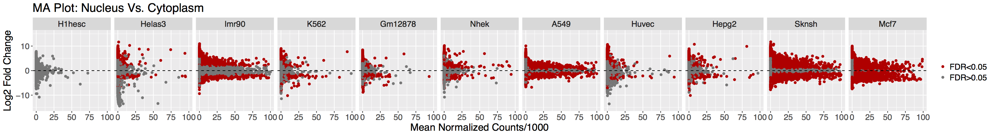
A.
Mean Normalized Counts/1000
Supplementary Figure 8: ENCODE Sample Disease Gene Set Association
MA plot showing the log₂ fold change between fractions (positive values indicate greater expression in nucleus) and mean normalized counts divided by 1000 for the 11 cell lines profiled by ENCODE. Red dots indicate FDR ≤ 0.05.

